Slide 1
Field validation of continental scale surface reflectance products from Landsat 8 and Sentinel-2
Medhavy Thankappan, Guy Byrne, Andrew Walsh, Fuqin Li, Tim Malthus, Cindy Ong, Ian Lau, Peter Fearns

Slide 2













Team members and reviewers
Janet Anstee
Hannalie Botha
Anjea Byrne
Mike Caccetta
Alicia Caruso
Laurie Chisholm
Ken Clarke
Claire Fisk
Erin Kenna
Fuqin Li
Stefan Maier
Glenn Newnham
Simon Oliver
Peter Scarth
Neil Sims
Kylie Smith
Liam Stephen
Lola Suarez
Dan Tindall
Lan-Wei Wang
Dennis Helder
Chris Maclellan
Kurt Thome
Stuart Phinn
Andreas Hueni
David Jupp

Slide 3
Outline
Background
Validation sites
Protocols
Results
Sensitivity analyses
National Spectral Database
Summary

Slide 4
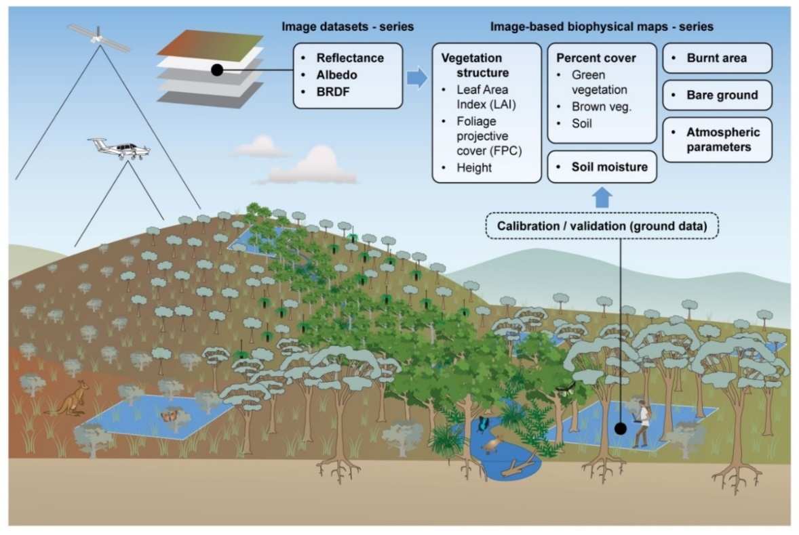

Background
Field data collection for continental scale validation of surface reflectance
Coordinated by CSIRO under a Project Agreement, funded through Digital Earth Australia (DEA)
Field data acquisition, near-coincident with satellite overpass (L8, S2a, S2b), commenced in March 2018 and continues
Field based validation using best practice protocols seen as critical to ensure generation of consistent multi-sensor ARD products such as SR
Reliability, consistency of downstream products, user confidence and uptake

Slide 5
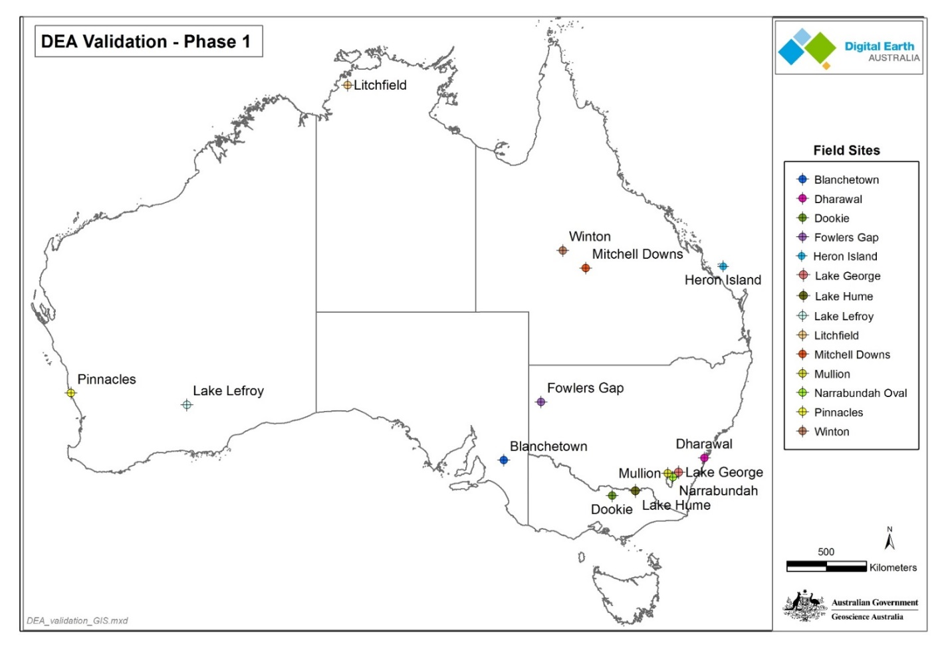
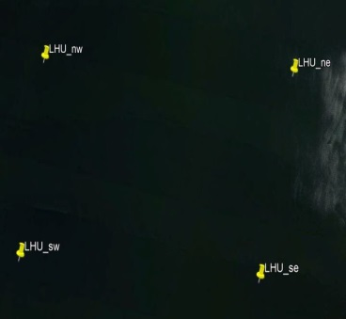
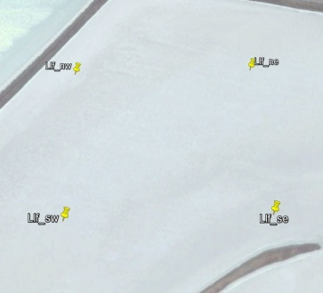
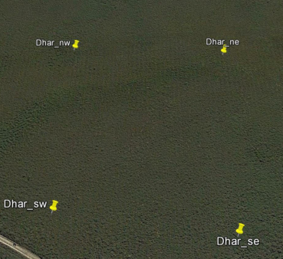
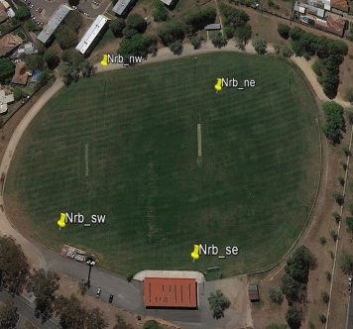
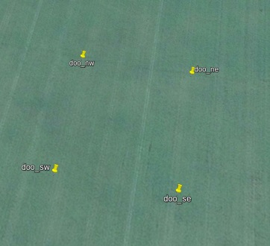
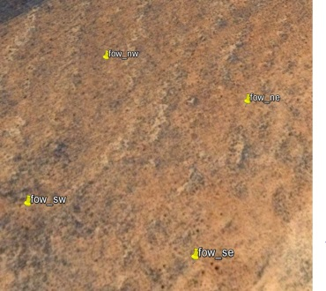
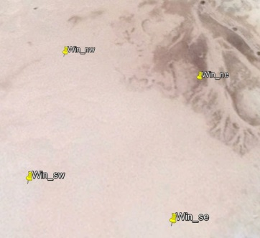
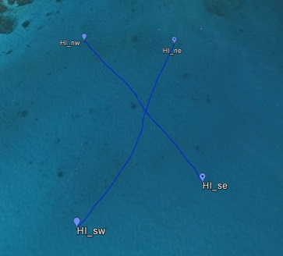
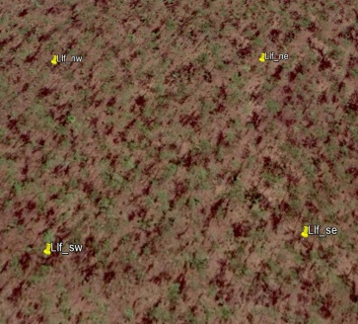
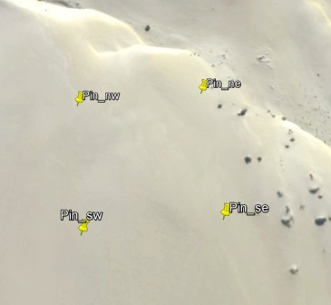
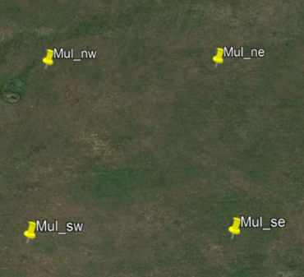
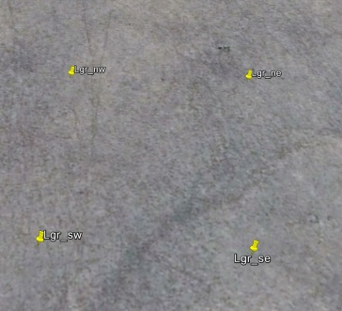
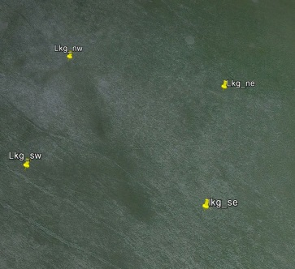
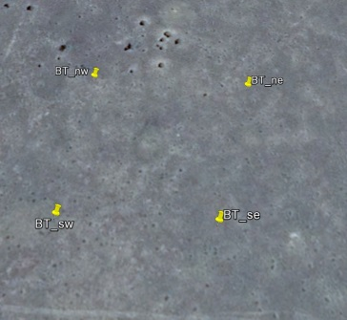
Surface Reflectance Validation Sites
Surface types
‘mostly’ flat
bare or low vegetation
homogeneous
spectrally diverse

Slide 6
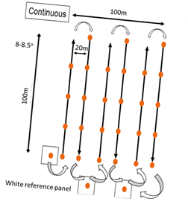
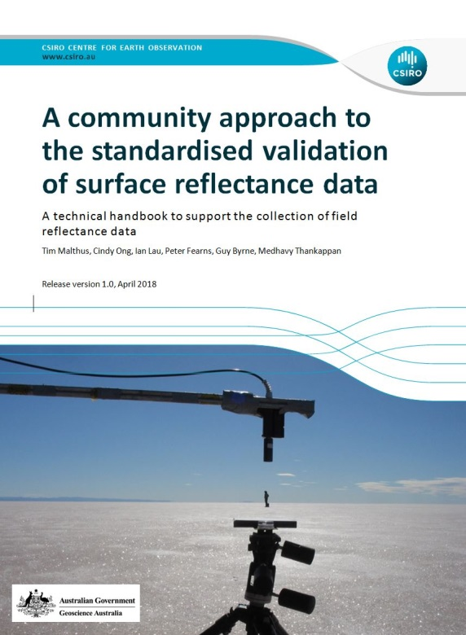
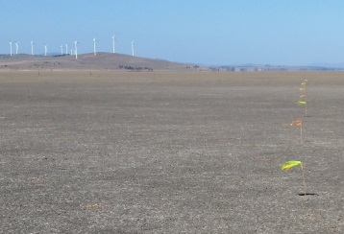
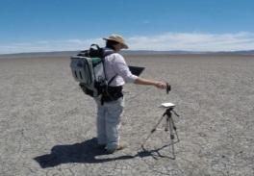
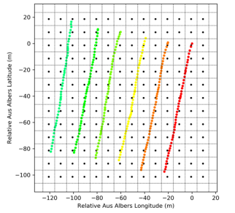
Field Sampling Protocol
All instruments / panels were characterised by CSIRO
100x100m sites
6 transects in each site oriented on the solar azimuth
Atmospheric readings coincident with overpass using either MicroTops or ASD
Transects bookended by panel readings
SR field validation protocols documented

Slide 7
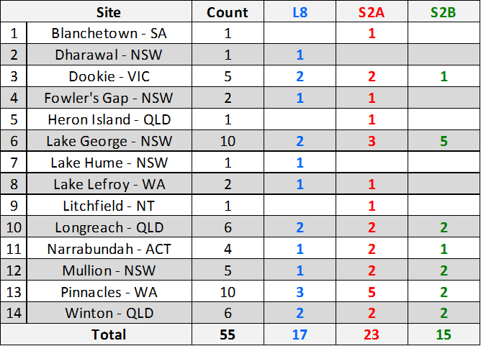
Current Data Collection Status
55 individual overpasses, multiple dual overpasses, and sampling temporally offset from overpasses, trial UAS acquisition.
Weather, site proximity, trafficability, equipment and staffing impacted on number of actual opportunities to deploy.
Work on characterising measurement uncertainty (Fearns et al in this session)
Total field data acquisitions at all sites

Slide 8
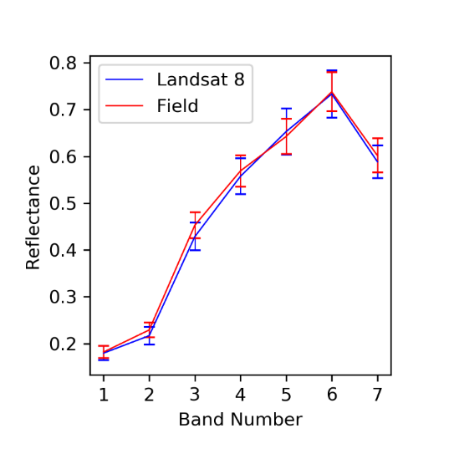
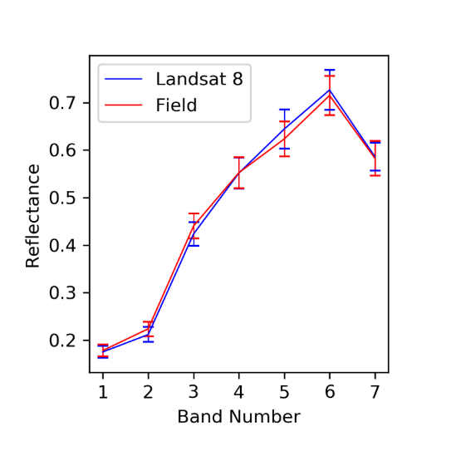
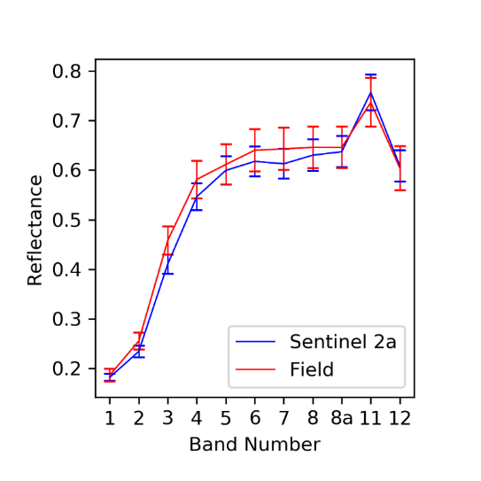
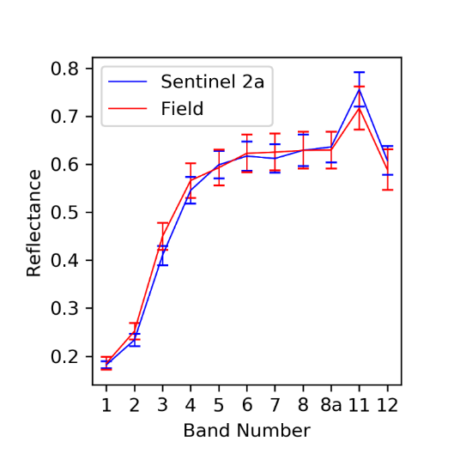
Coincident measurements with two ASDs
Coincident measurements with two instruments at Pinnacles site
Landsat 8 overpass on 20 May 2018
Sentinel-2A overpass on 22 May 2018
GA ASD
CSIRO ASD
GA ASD
CSIRO ASD

Slide 9
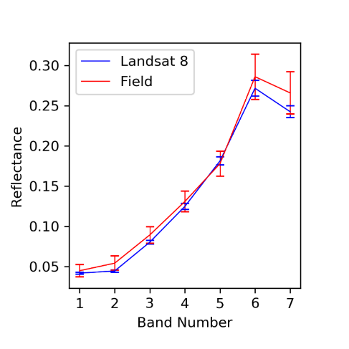
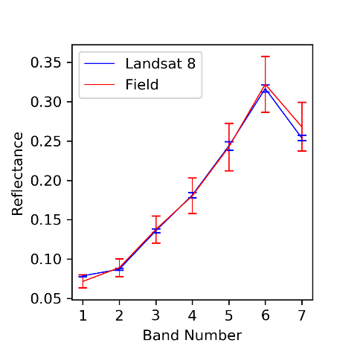
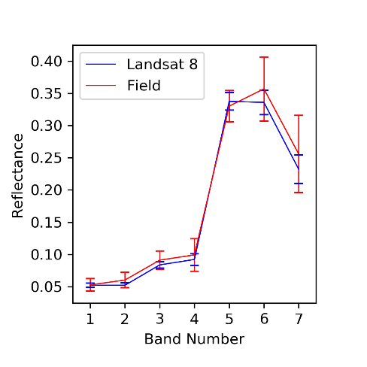
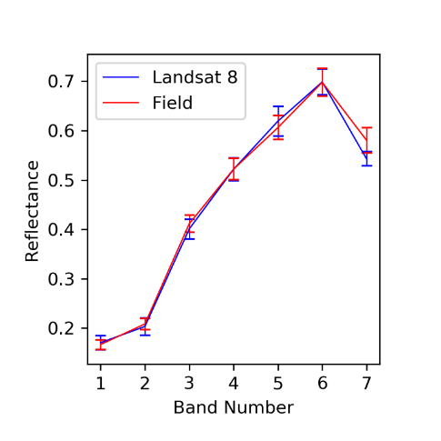
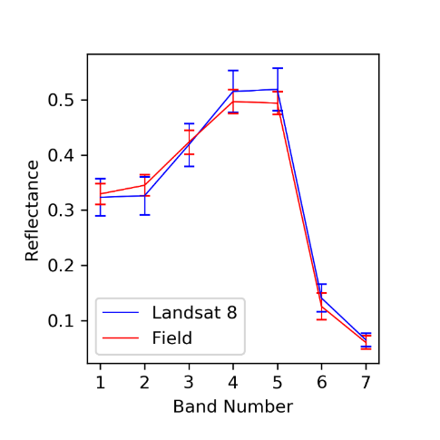
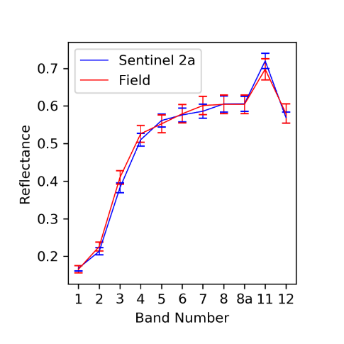
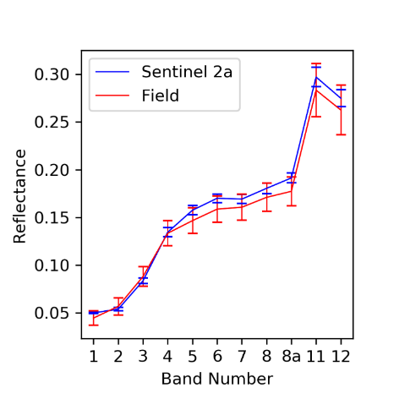
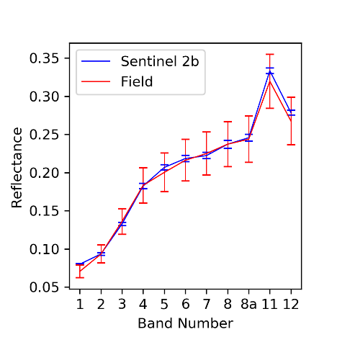
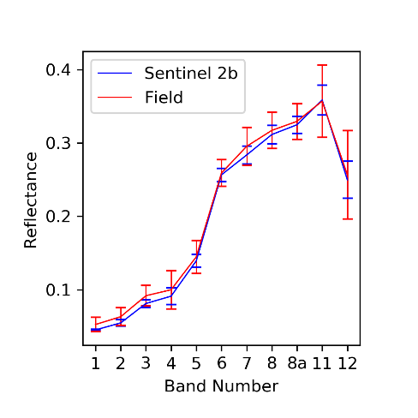
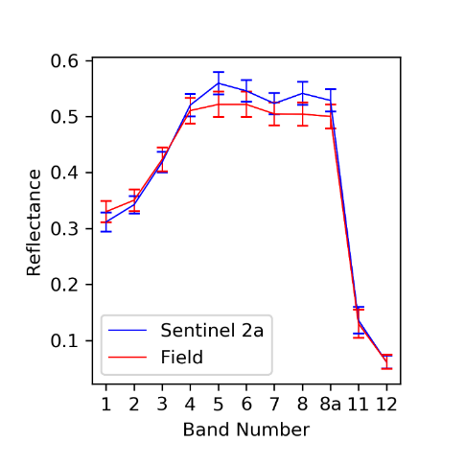
Validation for L8 and S2 Tandem Overpasses
Pinnacles 2 April 2018
L. Lefroy 25 June 2018
Dookie 2 June 2018
Dookie 2 June 2018
Longreach 23 June 2018
Mullion 10 April 2019

Slide 10
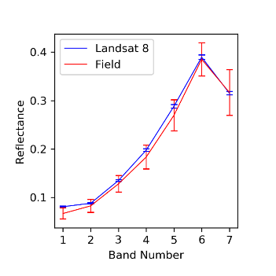
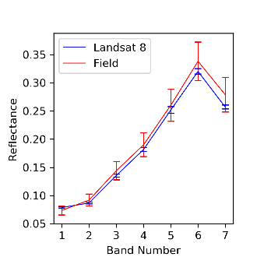
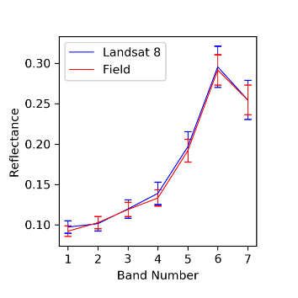
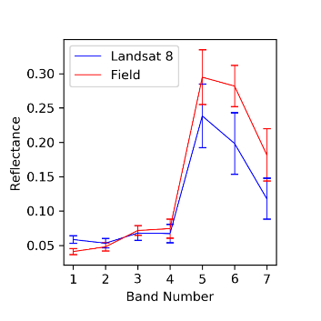

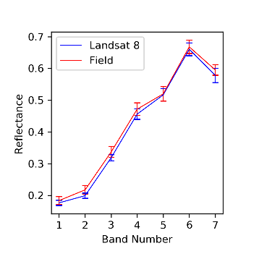
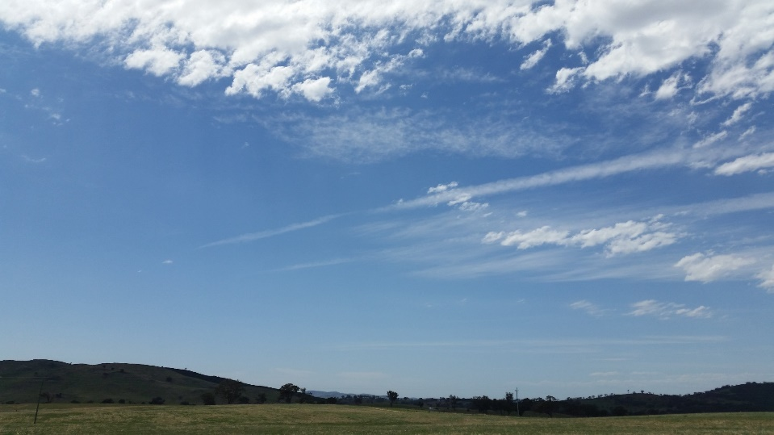
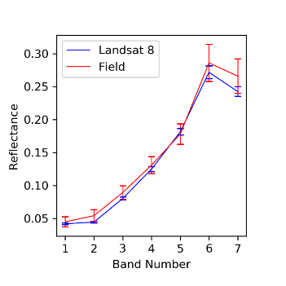

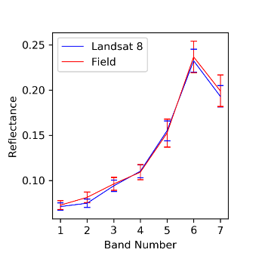
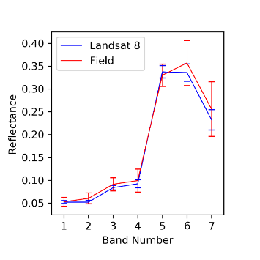

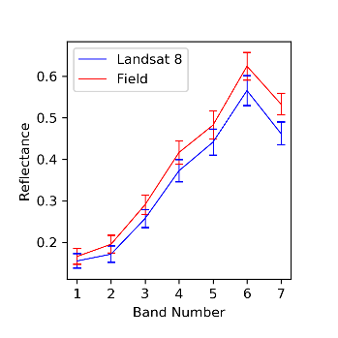
Temporal measurements for Landsat 8
Dookie 14 Mar 18
Longreach 29 May 18
Lake George 12 Feb 18
Mullion 29 Dec 18
Pinnacles 2 Apr 18
Winton 21 Jun 18
Dookie 2 Jun 18
Longreach 23 Jun 18
Lake George 3 May18
Mullion 10 Apr 19
Pinnacles 20 May 18
Winton 20 Oct 18

Slide 11
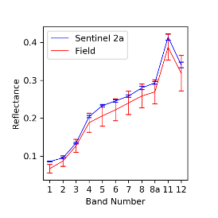
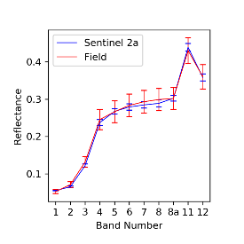
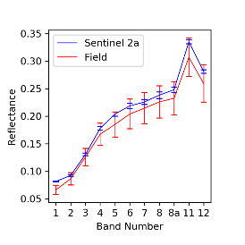
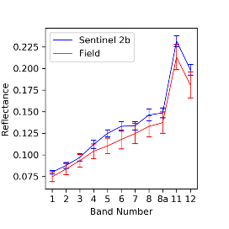
















Temporal measurements for Sentinel-2
Dookie 14 Mar 18
Fowlers Gap 21 Jun 18
Longreach 9 May 18
Lake George 5 Apr 18
Mullion 29 Dec 18
Pinnacles 2 Apr 18
Winton27 May 18
Dookie 18 Apr 18
Fowlers Gap 18 Dec 18
Longreach 23 Jun 18
Lake George 4 Jul 18
Mullion 8 Apr 19
Pinnacles 22 May 18
Winton21 Jun 18
Dookie 2 Jun 18
Longreach 9 May 18
Lake George 17 Sep 18
Mullion 10 Apr 19
Pinnacles 28 Nov 18
Winton 19 Oct 18

Slide 12





Drone Based Validation at Litchfield
Drone based spectral data collection trial over Litchfield site, synchronous with a Sentinel-2A overpass
Miniature Spectrometer
Site overview (Litchfield, NT)
Pre-flight reference panel measurement
Measuring direct irradiance

Slide 13



Field Validation Summary Results
Landsat-8
Sentinel-2A
Sentinel-2B

Slide 14
Sensitivity Analyses for SR
Parameters | Low | Medium | High
Aerosol optical depth | 0.05 | 0.25 | 0.50
Water vapor (g/cm²) | 0.5 | 1.5 | 3.5
Solar angle | 25 | 45 | 70
BRDF | low | medium | high
Mean surface reflectance at different aerosol values
Mean surface reflectance at different values of solar angle normalisation
Mean surface reflectance at different water vapour values
Mean surface reflectance at different BRDF levels

Slide 15


National Spectral Database
Field spectral data collected for validation of SR will be managed as a national collection
Work on deploying the database for access through cloud based services in progress
The National Spectral Database will be freely accessible by the EO community

Slide 16
Summary
Ongoing field based validation is critical to ensure consistency in generation of ARD products such as SR from multiple sensors
Protocols developed for continental-scale field validation of SR, can be adopted for global use
Sensitivity analyses highlight the relative importance of parameters used for generating SR, and their impacts
Quantifying measurement uncertainty will help define ‘fit for purpose’ SR products
The National Spectral Database will provide free access to field data

